Slide 1
A színfalak mögött - TALOS
Csorás Szilárd
IT biztonsági tanácsadó

Slide 3
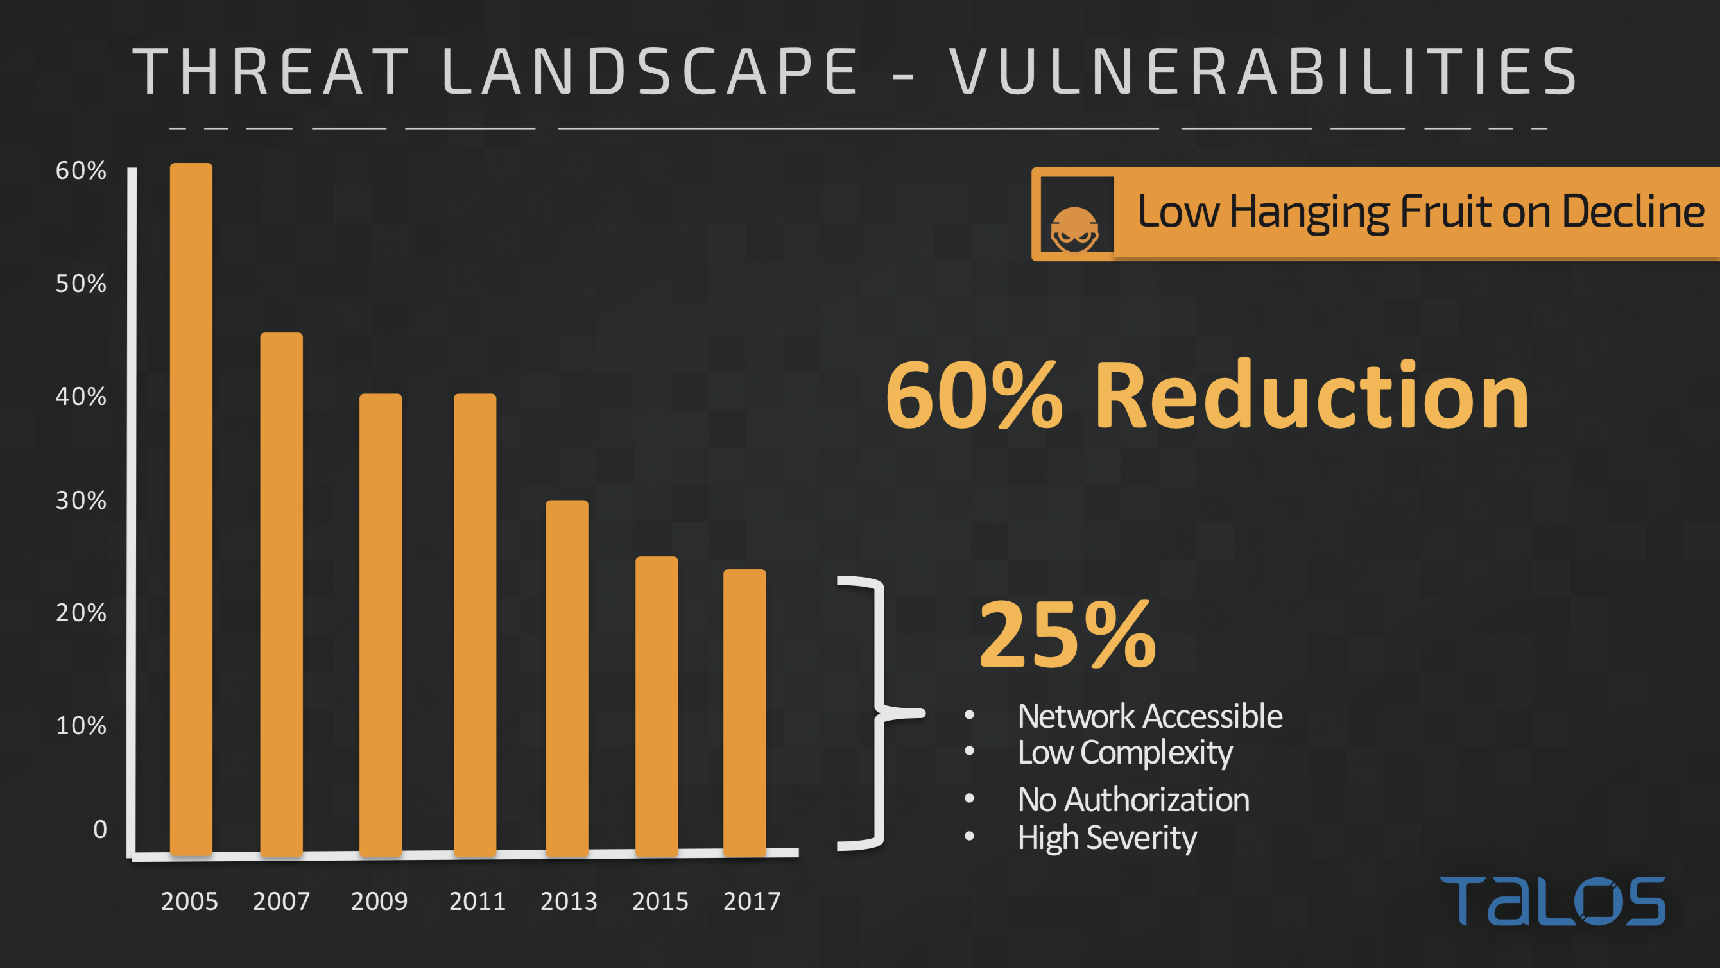

Slide 4
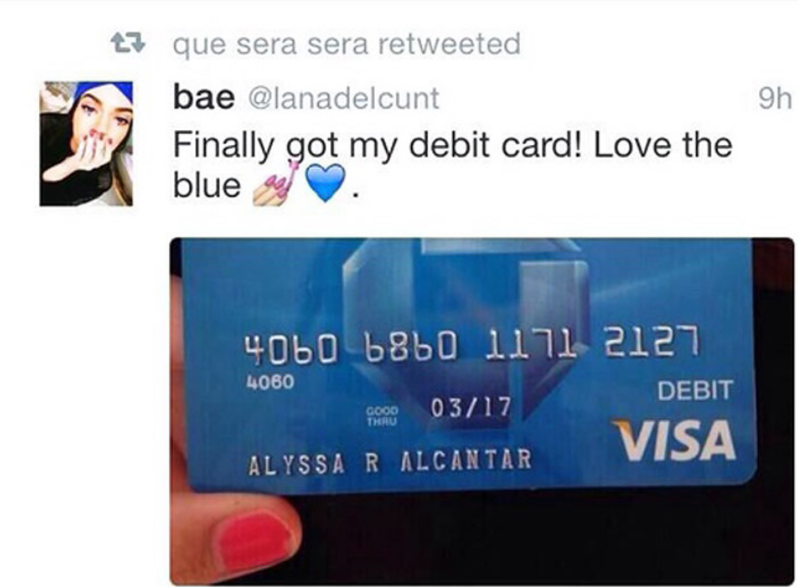
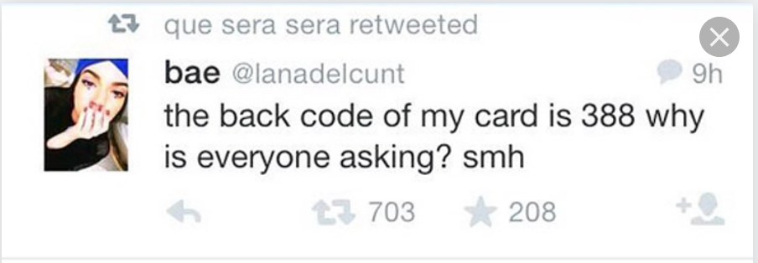
The Unpatchable Vulnerability

Slide 5
Threat Intelligence
Industry Sharing Partnerships (ISACs)
Internet-Wide Scanning
Daily Malware Samples
Product Telemetry
Daily Web Requests
3rd Party Programs (MAPP)
Service Provider Coordination Program
Open Source Intel Sharing
Daily Email Messages
Vulnerability Discovery
Honeypots
Customer Data Sharing Programs
1
Talos pulls threat data from Cisco’s telemetry, customer feedback, industry partnerships, and many other sources.
Threat Data Cycle

Slide 6
Threat Intelligence
Threat Data
• Email Samples
• Web Samples
• Malware Samples
Data Aggregation
Data Analysis
2
Threat data is aggregated and analyzed. Analysis of false negatives and false positives.
Threat Data Cycle

Slide 7
Threat Intelligence
Security Solutions
All Cisco
Security Products
3
Security solutions are developed to prevent and address threats. These solutions and updates are pulled down by Cisco Security products.
Threat Data Cycle

Slide 8
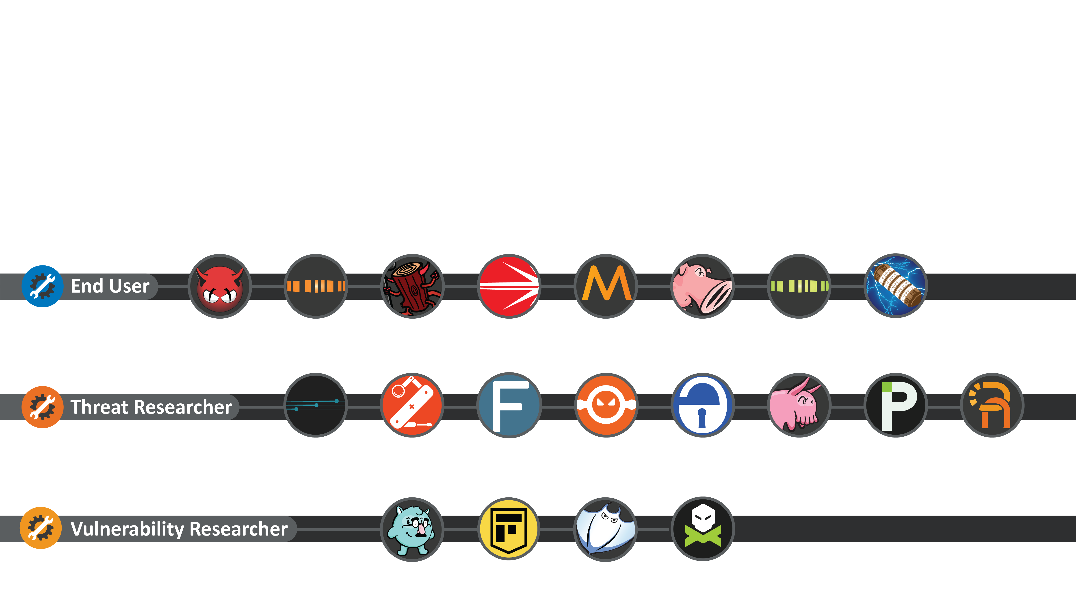
Forcing the Bad Guys to Innovate
Empowering End Users with Open Source Tools
Talos provides a number of free tools and resources to the public in order to help users better protect themselves from security threats. We are constantly adding new tools to our library to keep abreast of new threats.
Notes:
Missing Spamcop and Talos Reputation Center

Slide 9
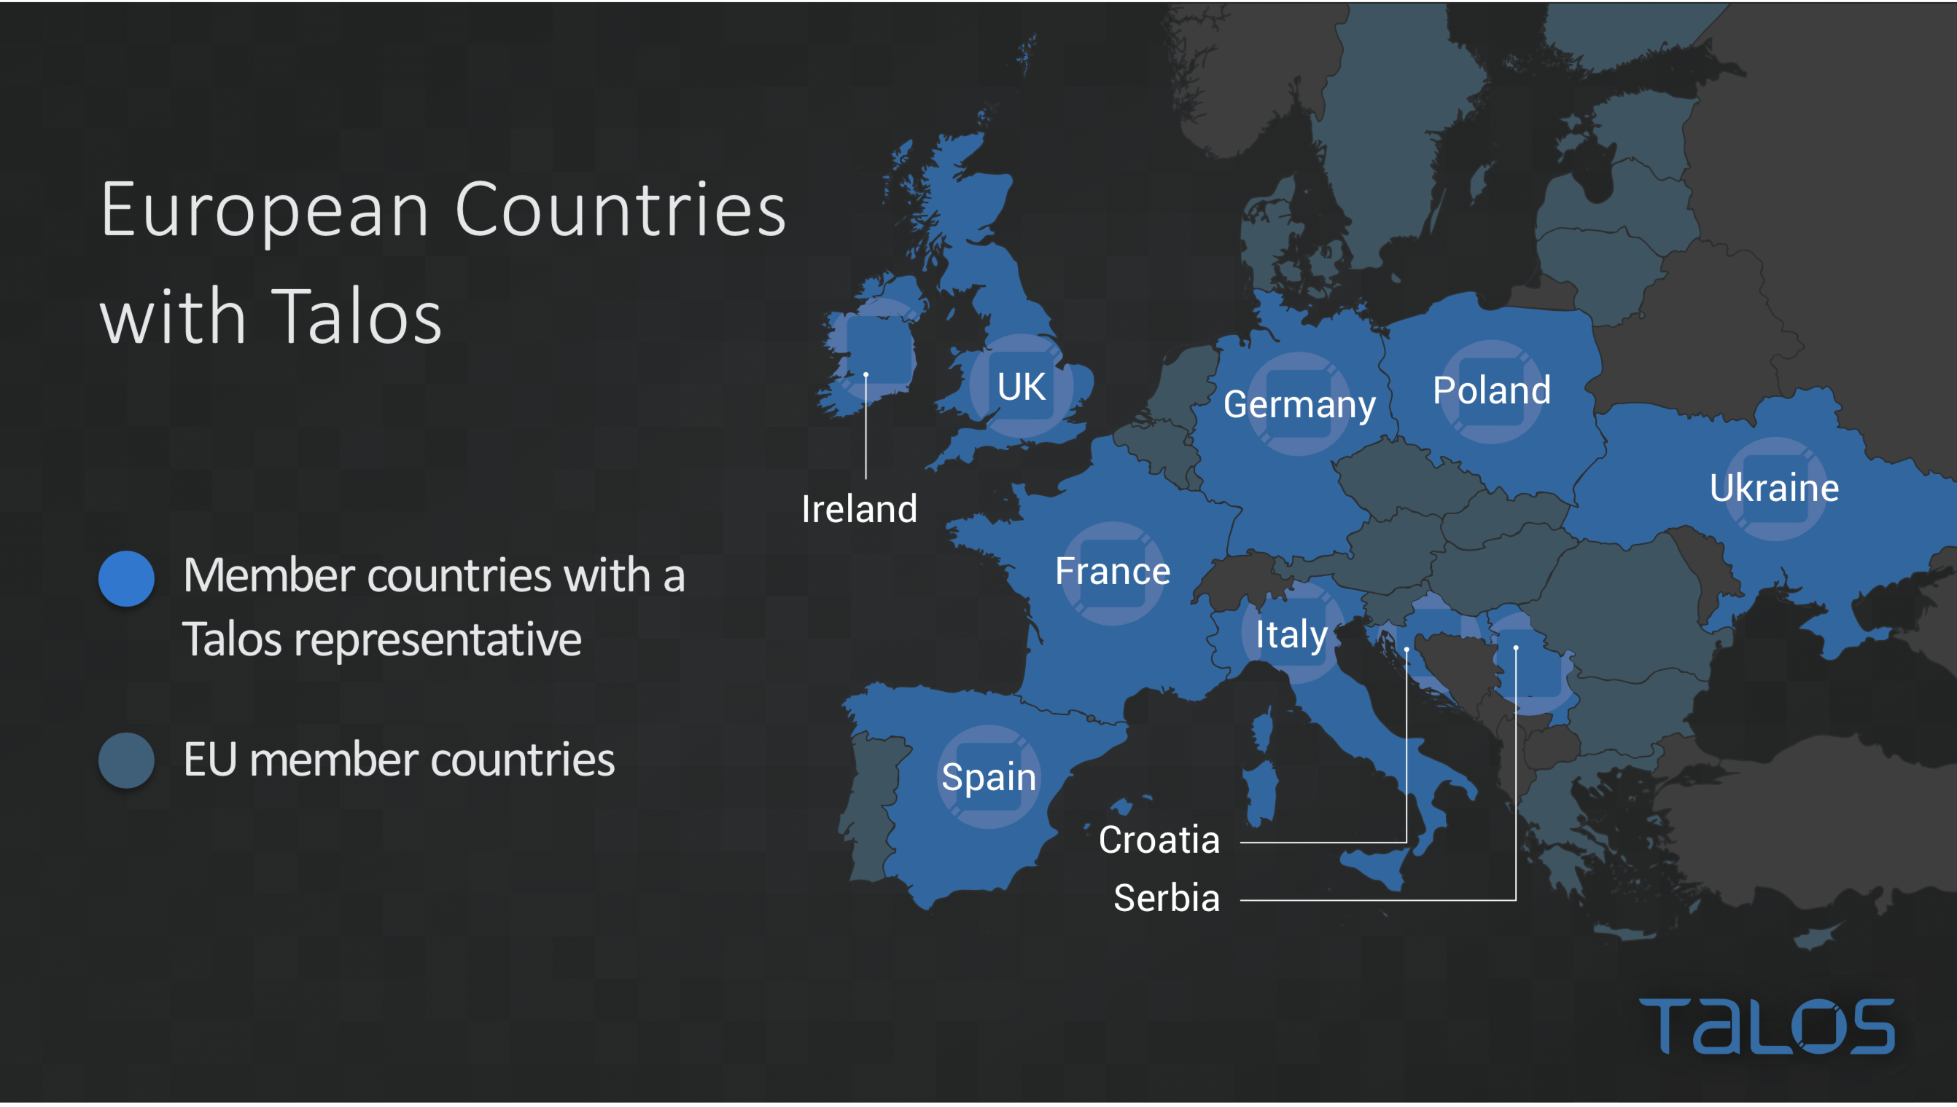

Slide 10


Slide 11
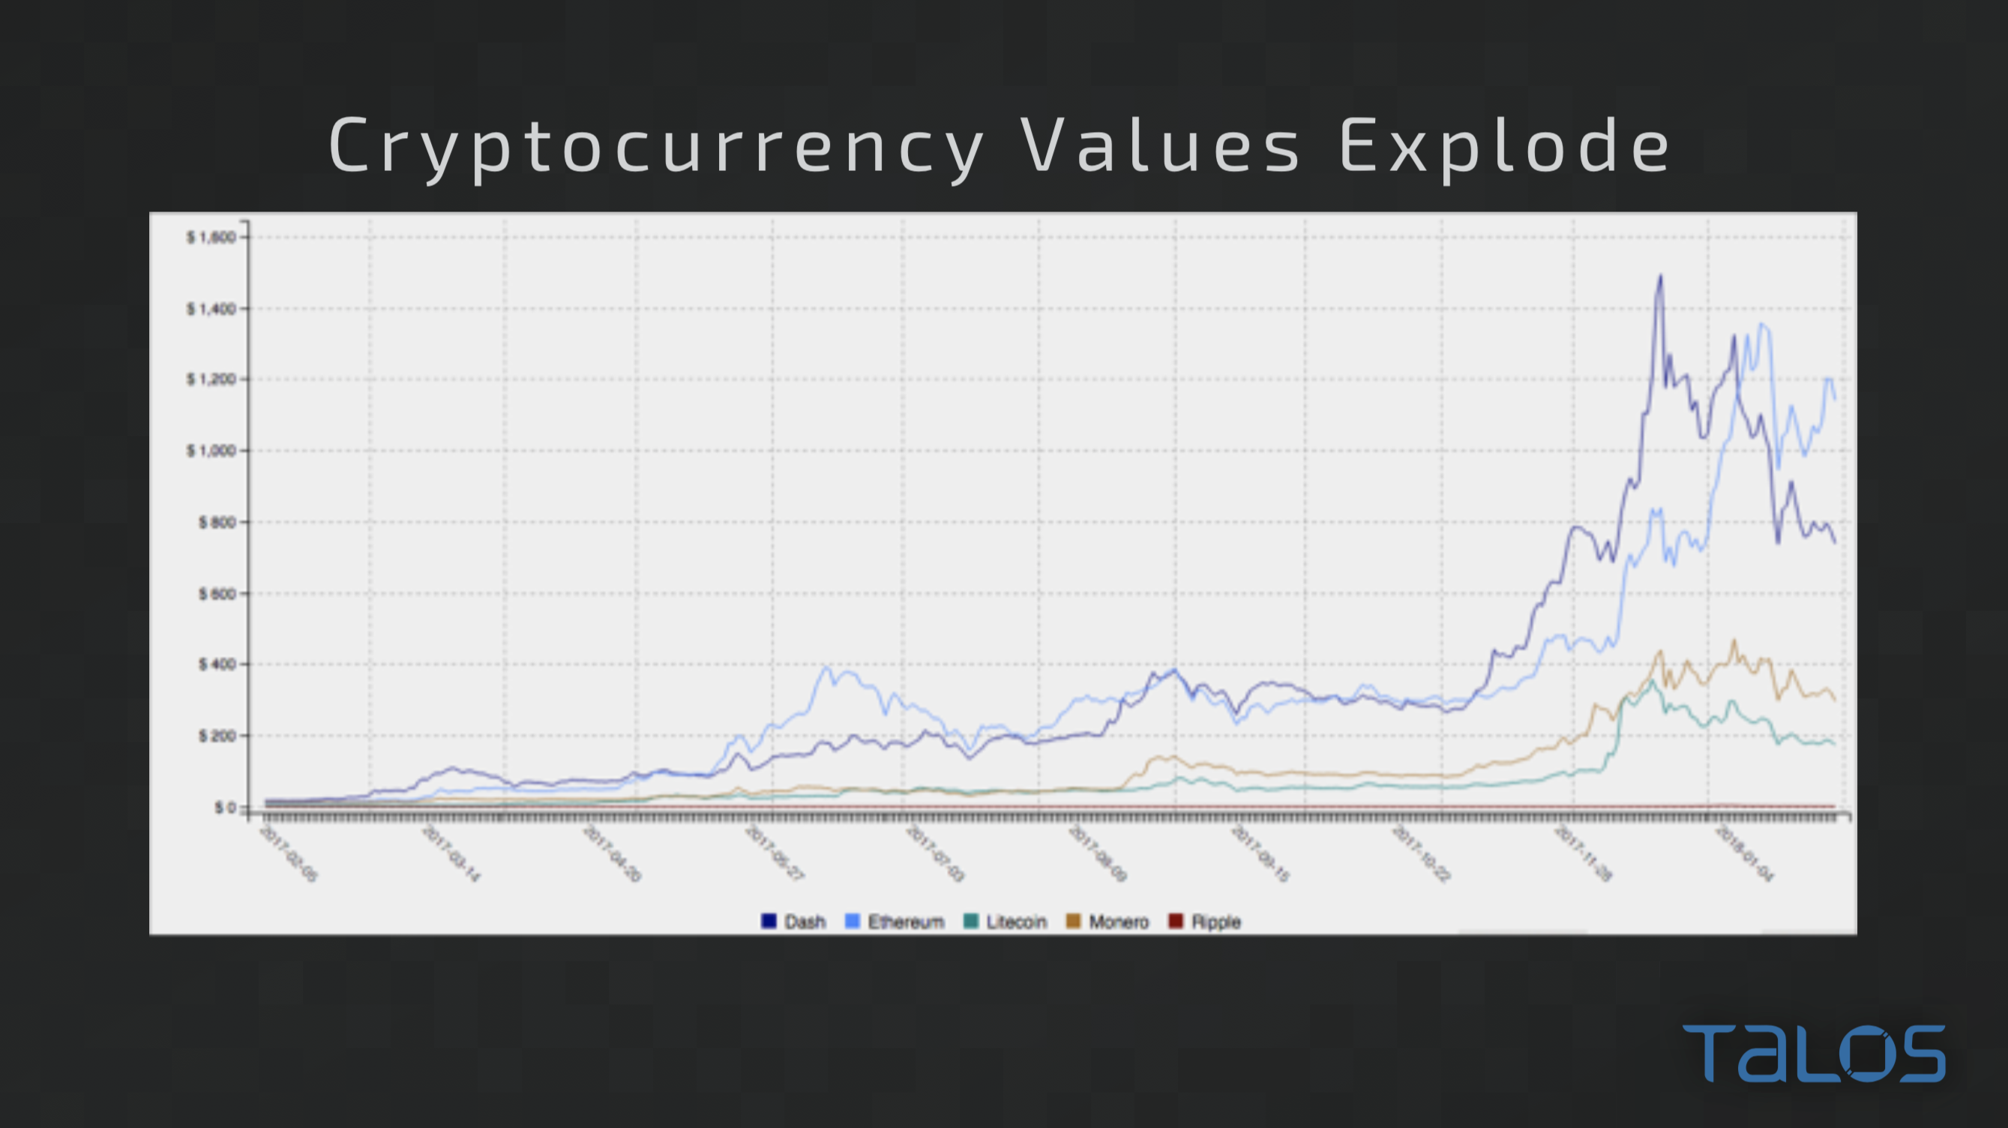

Slide 12
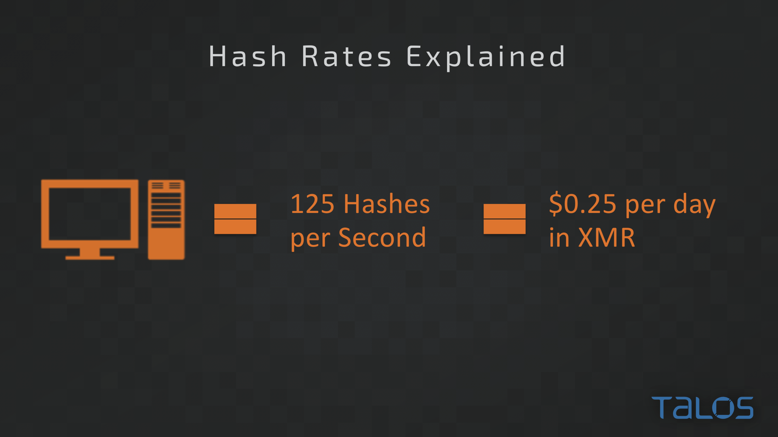

Slide 13
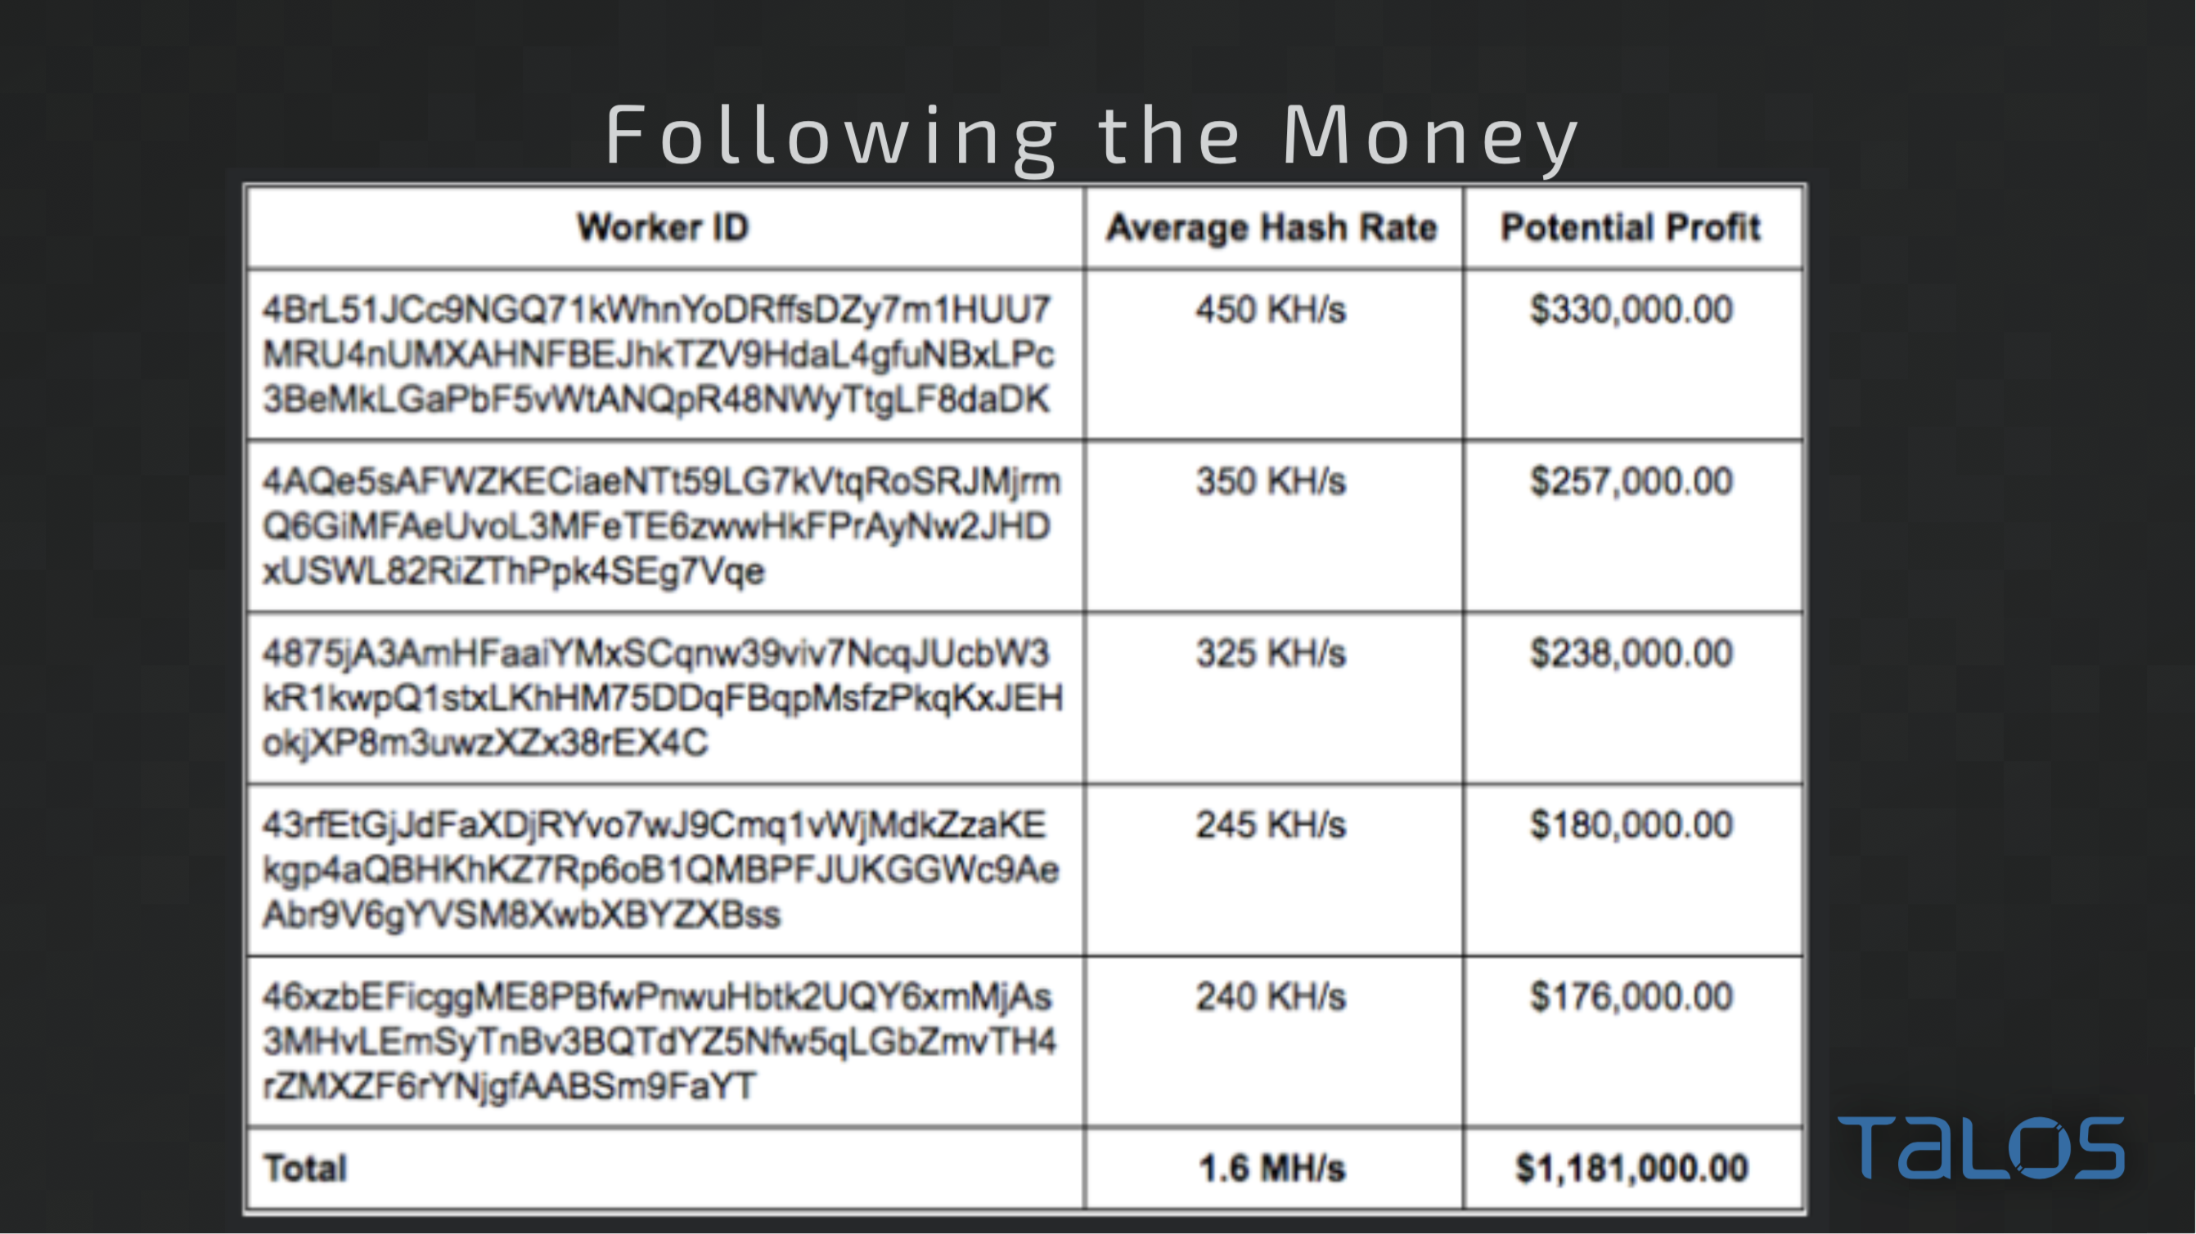

Slide 14
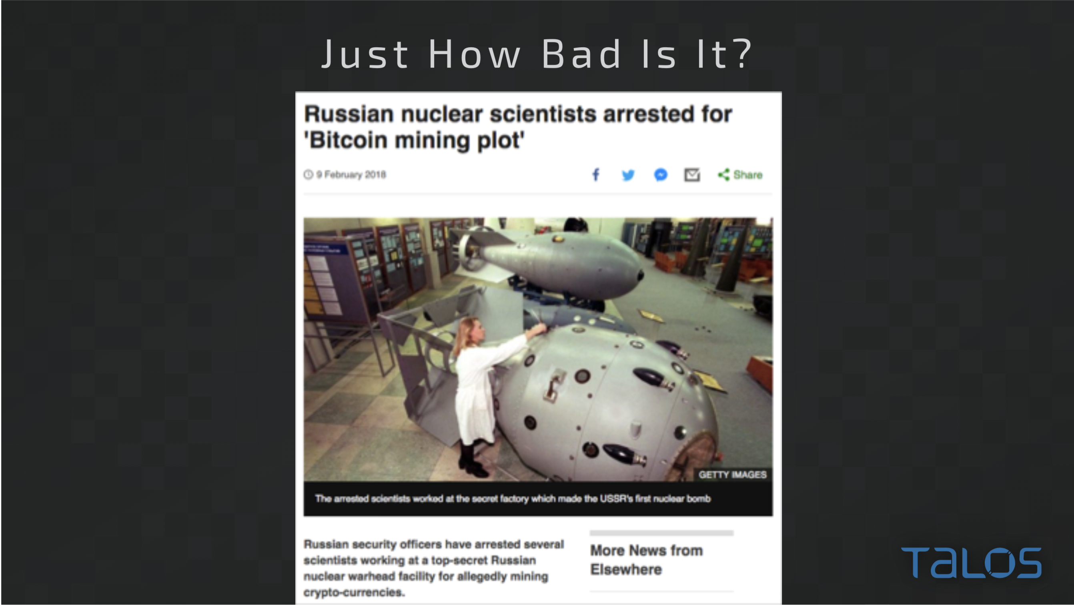

Slide 15
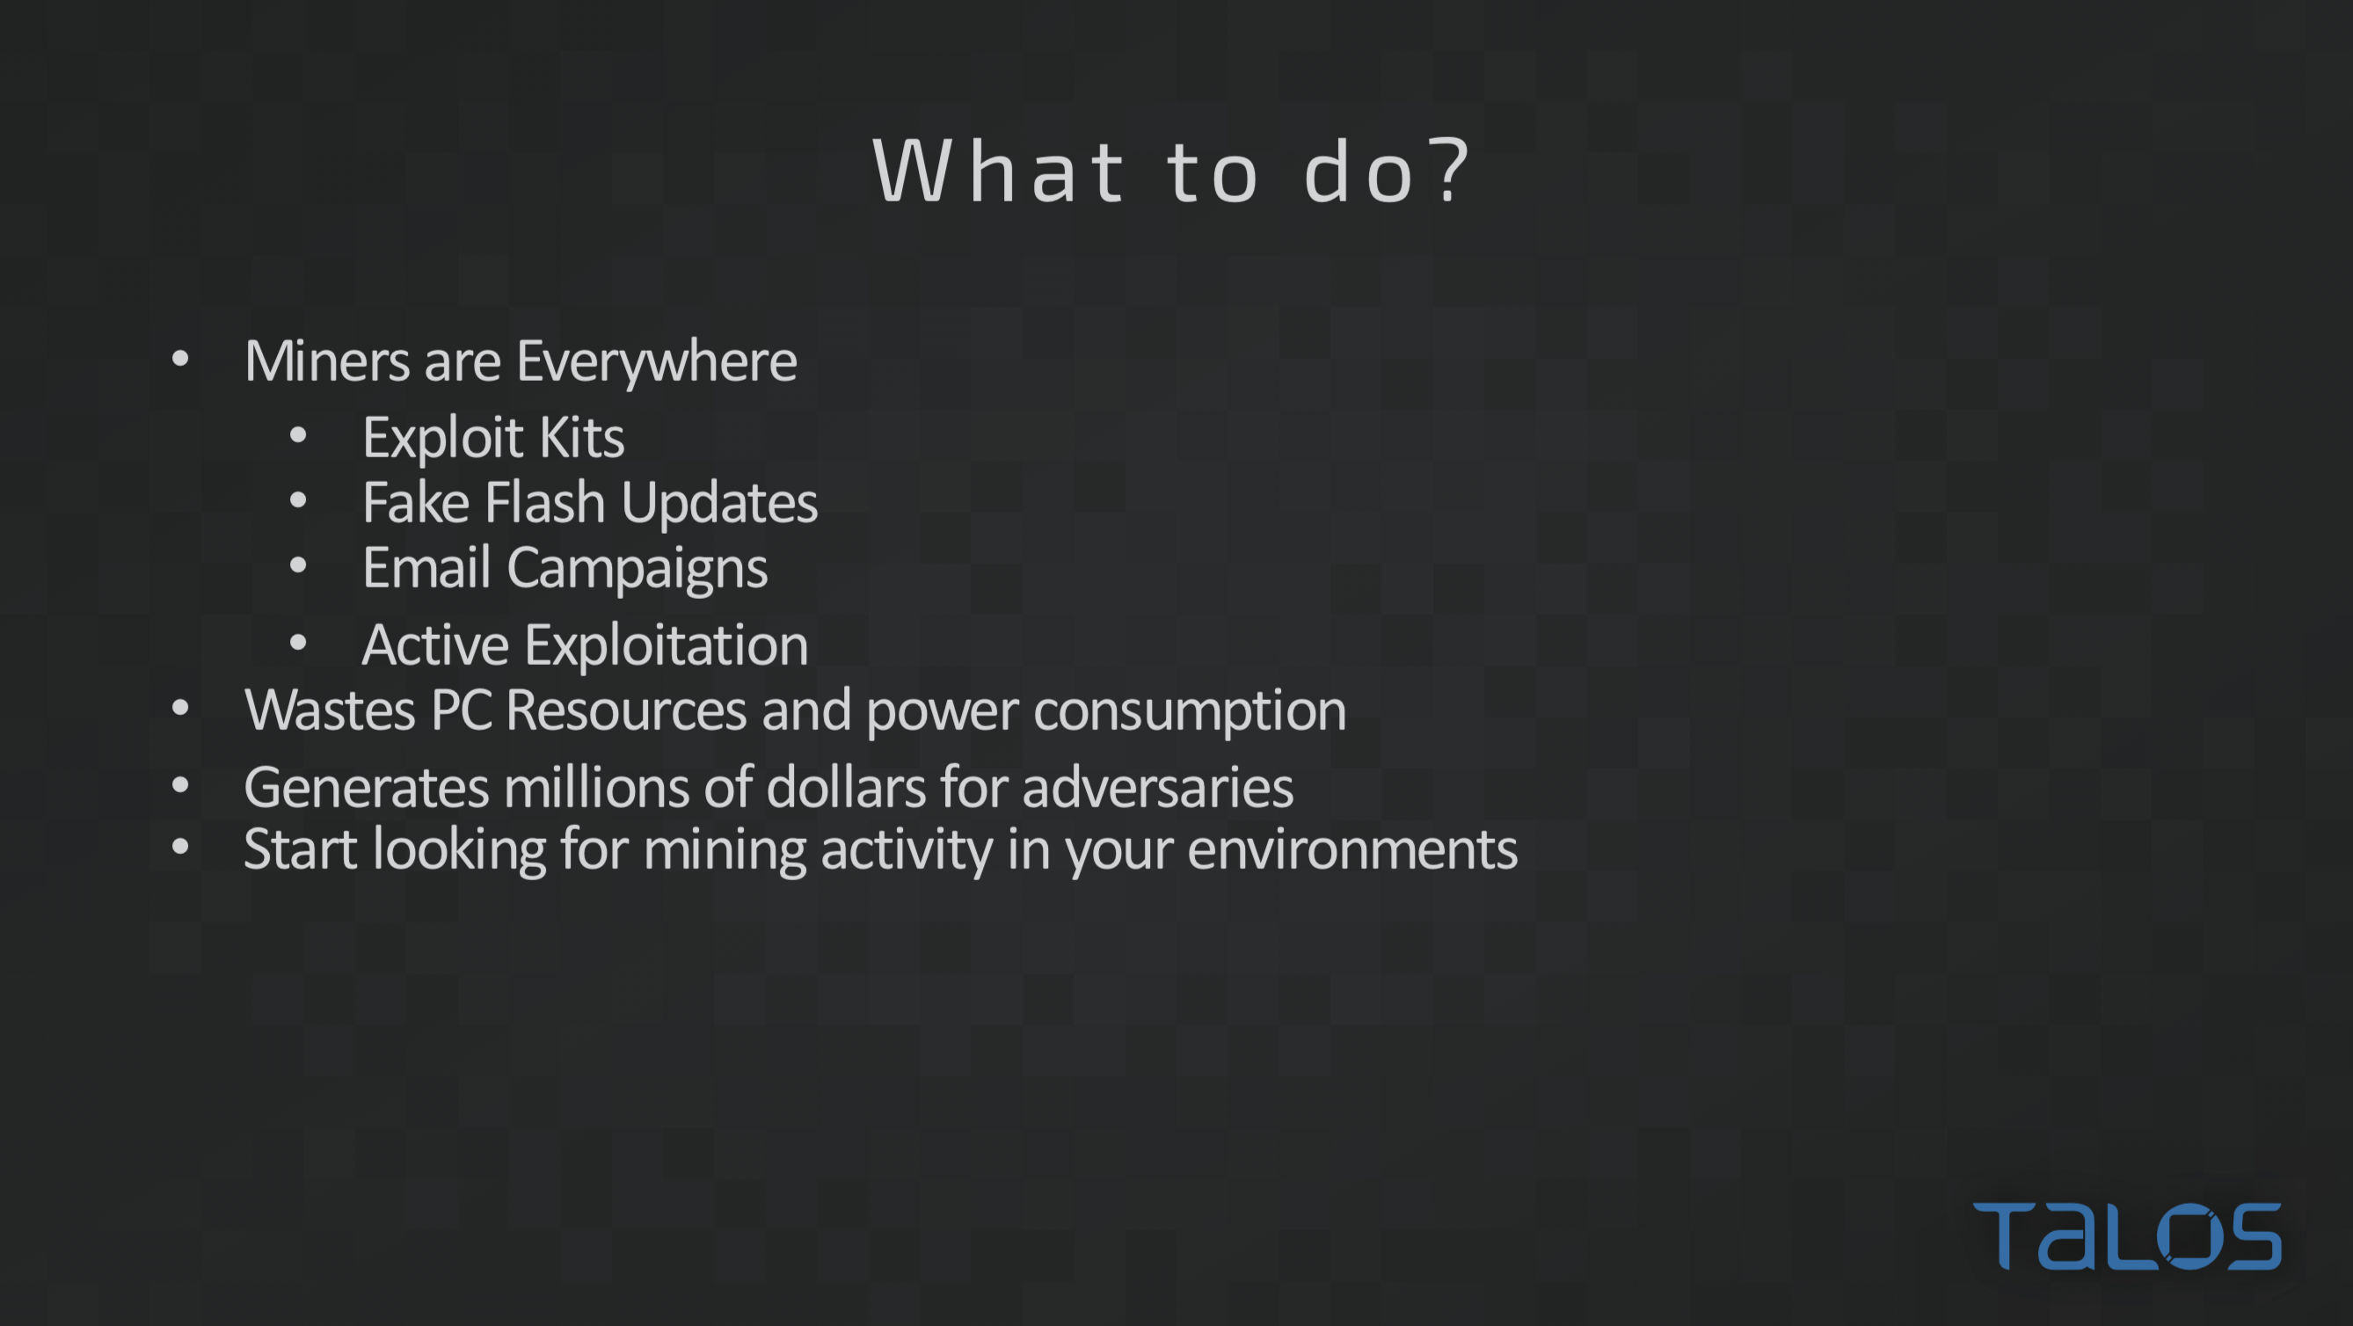

Slide 16
Forcing the Bad Guys to Innovate
Spreading security news, updates, and other information to the public.
White papers, articles, & other information
talosintelligence.com
ThreatSource Newsletter
cs.co/TalosUpdate
Talos Blog
blog.talosintelligence.com
Social Media Posts
Facebook: TalosGroupatCisco
Twitter: @talossecurity
Instructional Videos
cs.co/talostube
Beers with Talos Podcast
talosintelligence.com/podcasts
Talos publically shares security information through numerous channels to help make the internet safer for everyone.

Slide 17


Slide 18
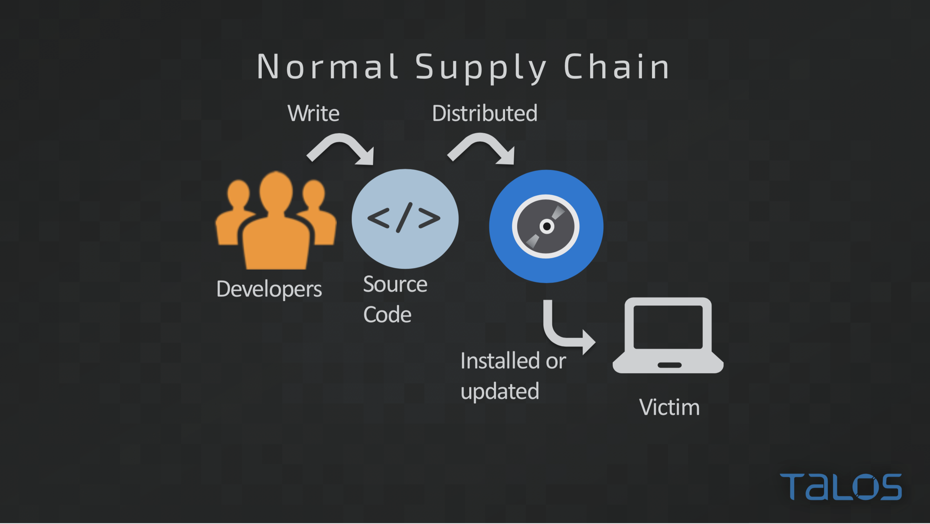

Slide 19
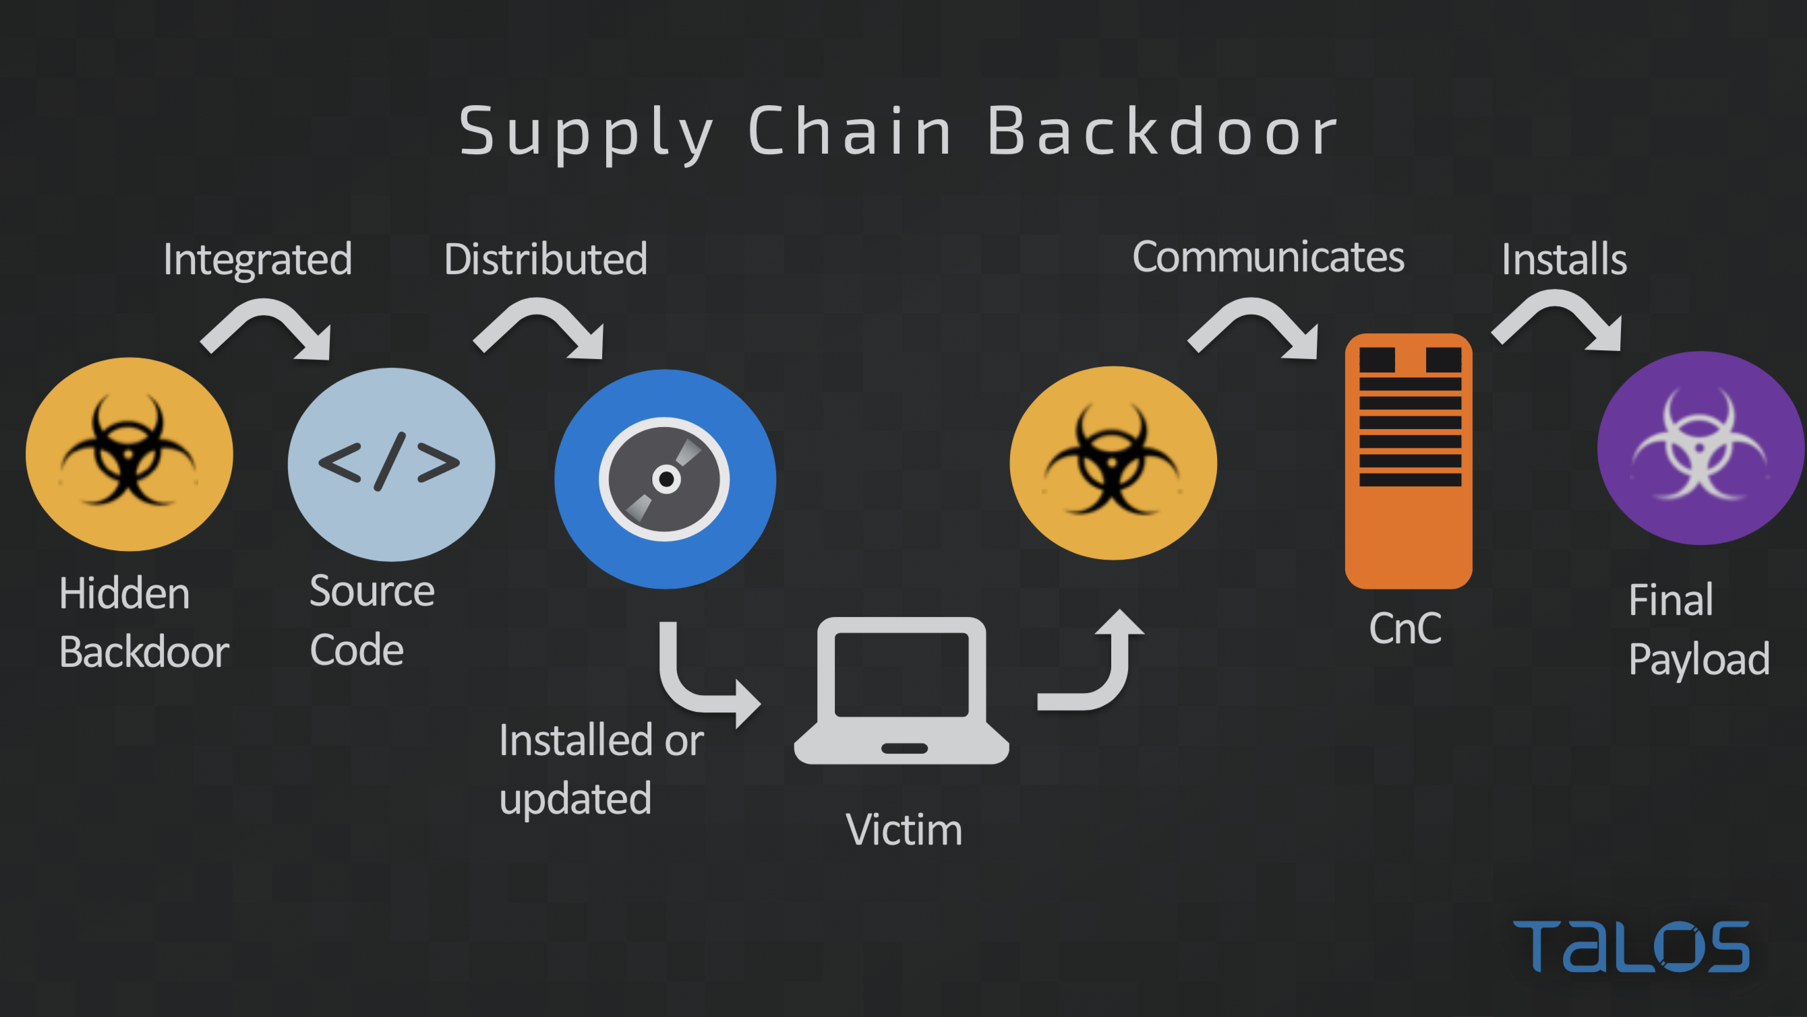

Slide 20


Slide 21
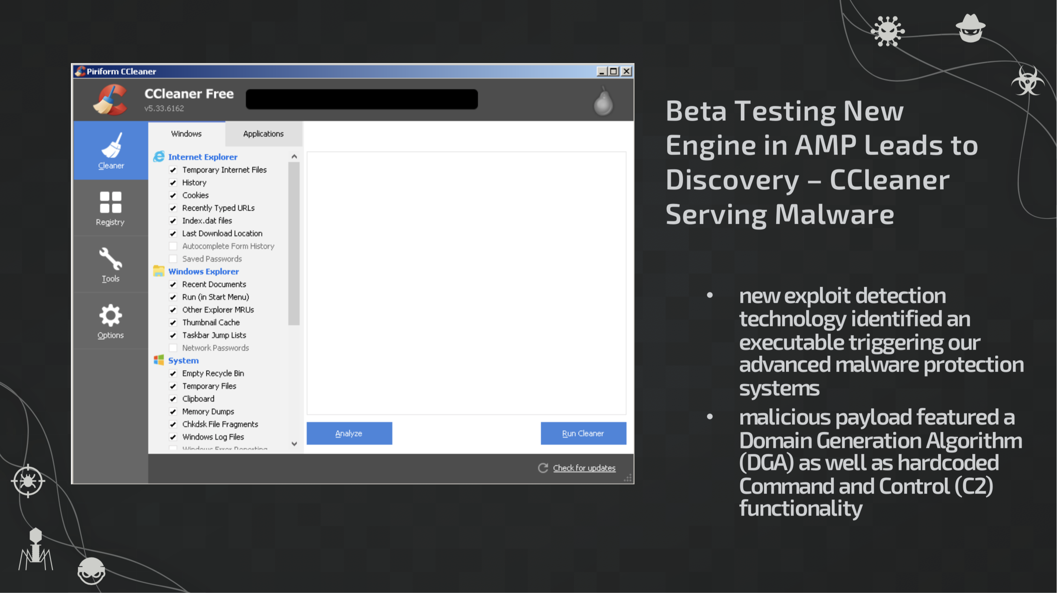

Slide 22
